Slide 1
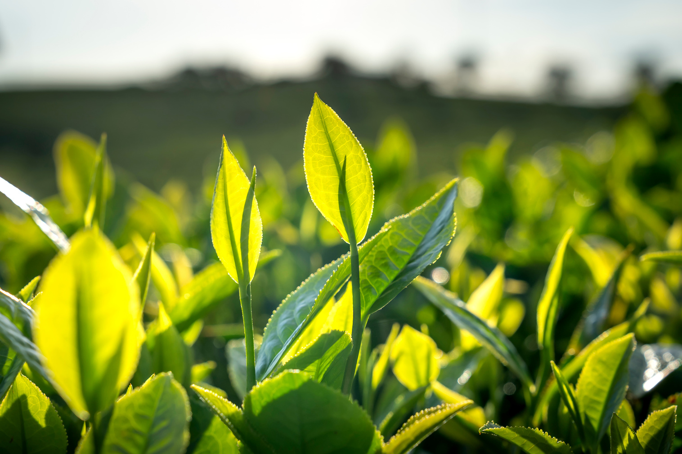
Predictive Analytics
Project
Kerala Flower & Plant Disease Classification Using Color and Texture Features
Group Members:
Aparna Sreenivasan (253204) - Bio-AI
Ayana Santhosh Khan (253217)-Bio-AI
Shiha Shajahan (253310)-Gis

Slide 2
Presentation Outline
1. Problem Statement
2. Objective
3. Dataset Overview
4. Methdology
5. Data Preprocessing
6. Feature Extraction
7. Feature Selection
8. Model training
9.Evaluation metrics and results
10.Visualization
11. Deployed Application
12.Conclusion
13.Future Work

Slide 3
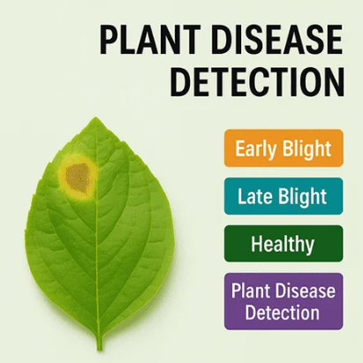
Problem Statement
Agricultural Challenge
Plant diseases causes crop loss and can affect the crop quality and reduce agricultural productivity
Manual disease detection is time consuming
Some of the plant diseases
Leaf Mold
Early blight
Late blight

Slide 4
Objective
Use of machine learning model for plant disease detection
It uses the leaf images for the disease prediction
Accessible via the browser
Easy to use

Slide 5
Overview of the Dataset
Dataset used - PlantVillage Dataset (From Kaggle)
Containing 54,305 images across 38 different disease classes.
This includes multiple crops like tomato, potato, and apple, with various diseases such as early blight, late blight, and healthy leaves.

Slide 6
Methodology
Data cleaning
Model training
Preprocessing
Evaluation
Feature extraction
Deployment

Slide 7
Data preprocessing
Loading all the images
Cleaning the data - Remove the corrupted images
Resizing the images - Make all the images into 128×128 pixels
Color conversion - BGR to HSV color space
Label encoding - Text labels to Number

Slide 8
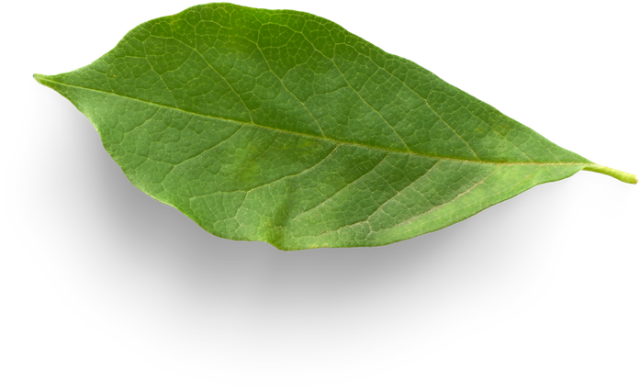
Feature Extraction
Extracted three features:
Color Features → HSV Histogram
Texture Features → Local Binary Pattern (LBP)
Shape Features → Hu Moments
Total: 801 features per image

Slide 9
Feature Extraction
Color (HSV Histogram)
Converted RGB → HSV
Captures discoloration (yellowing, dark spots)
Texture (LBP)
Pixel-wise comparison with neighbors
Detects roughness, spots, lesions
Shape (Hu Moments)
7 invariant moments
Captures structure & deformities
Invariant to rotation & scaling

Slide 10
Feature Selection
Used Mutual Information
Reduced features from 801 → 100
Removed irrelevant/redundant features
Improved model efficiency & accuracy

Slide 11
Model Training & Comparisoning
Models used: Support Vector Machine (SVM), K-Nearest Neighbors (KNN), Random Forest
Applied StandardScaler
Performed training and testing
Used 5-fold cross-validation

Slide 12
Evaluation Metrics
Accuracy
F1-Score
Cross-validation accuracy

Slide 13
Results
SVM — Accuracy: 80.08%, F1: 79.64%, CV: 78.74%
KNN — Accuracy: 75.97%, F1: 75.90%, CV: 74.84%
Random Forest — Accuracy: 83.35%, F1: 82.84%, CV: 82.15%
Best Model: Random Forest

Slide 14
Feature Comparison
Color Histogram: 92.54%
LBP: 51.99%
Hu Moments: 27.47%
Combined Features: 93.31%
Combining features gives best performance

Slide 15
Visualization
Model comparison bar graph
Feature comparison graph

Slide 16
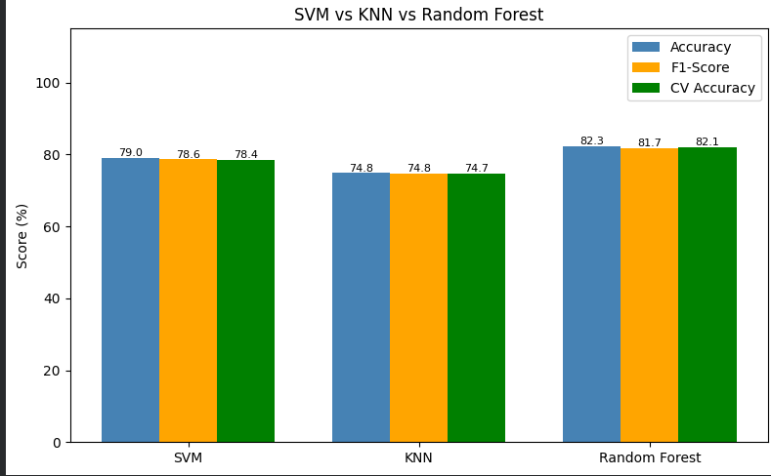
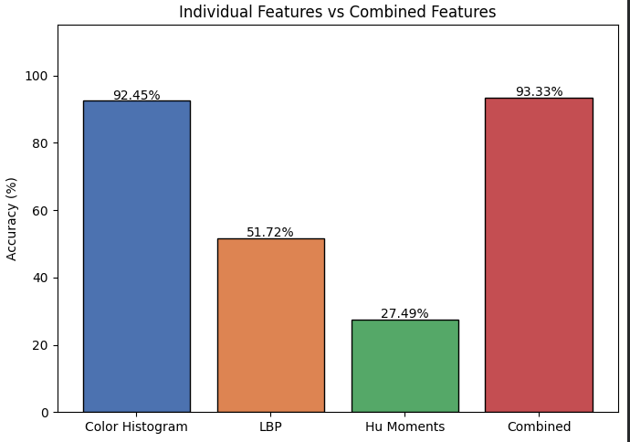

Slide 17
Deployed Application
Built using Streamlit
User uploads leaf image
System predicts disease instantly
Uses trained Random Forest model

Slide 18
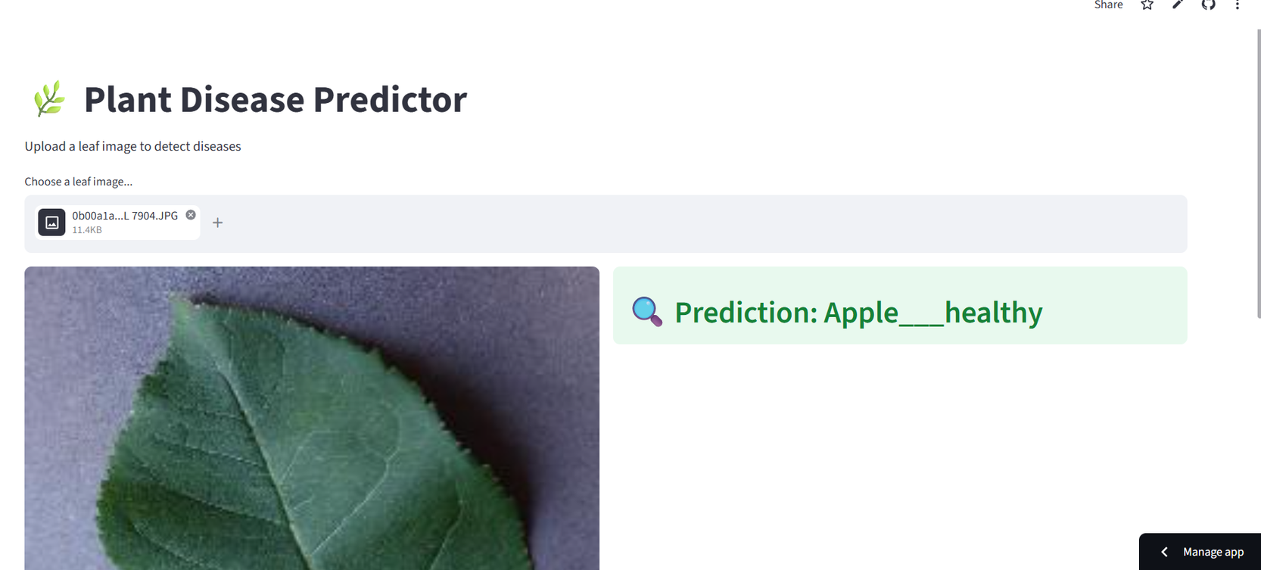
Output Demo
Input: Leaf Image
Output: Predicted Disease Label

Slide 19
Conclusion
Machine Learning enables early disease detection
Improves agricultural productivity
System is efficient and easy to use
Random Forest performed best among models

Slide 20
Future Work
Use Deep Learning (CNN) for better accuracy
Develop mobile application
Real-time disease detection
Expand dataset for more crops

Slide 21
Thank You

